Slide 1





SDA-Capstone -Blog App Deployment
A DevOps Implementation

Slide 2
Team Members
01
07
SDA2016 Hala Hasan Tahlawi
SDA2012 Raghad Alghamdi
02
08
SDA2040 Abdulaziz Nawawi
SDA2035 Afnan Alkhamisi
03
09
SDA2034 Asail AlAti
SDA2018 Reham Alamri
04
10
SDA2014 Ruqayyah Alruwaili
SDA2007 Waad Alharthi
SDA2026-ORJWAN HADI
05
11
SDA2023 Renad Alrehaili
06
SDA2028 Lamya Aldawsari
12
SDA2030 Layan Alharbi (Team Leader)
01

Slide 3
Project Vision
01
02
03
Deliver a secure and scalable blog deployment on AWS.
Implement modern DevOps practices for automation and efficiency.
Ensure reliability, high availability, and continuous improvement.
02

Slide 4
1.Introduction
The SDA-CAPSTONE Blog Page Application is a comprehensive project aimed at deploying a blog web application using the Django framework on AWS. This application is designed to operate within an isolated Virtual Private Cloud (VPC) environment, ensuring security and scalability.
03

Slide 5
2.Demo Overview
01
03
05
Problem
02
Architecture
04
Challenges and lessons learned
The need for a scalable and secure Django framework blog deployment.
Architecture overview and key components and Their Interactions.
Solution
Live demonstration
Discussing the challenges faced During deployment and the valuable lessons learned.
Using AWS Infrastructure with Infrastructure as Code (IaC) and Monitoring
Live demonstration of the functionalities and Performance of the deployed application.
04

Slide 6
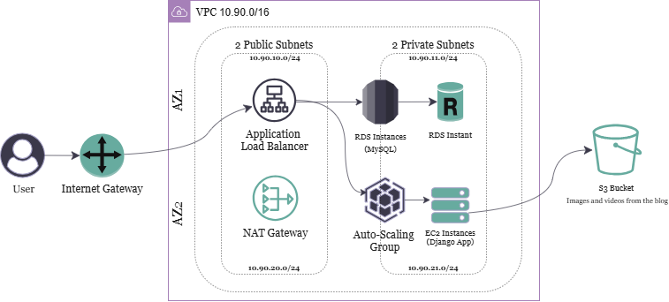
3.Architecture Overview
05
SDA2034 Asail AlAti

Slide 7
4.Technologies & Tools
1. Infrastructure as Code: Terraform
Terraform provisions and manages AWS infrastructure through code (.tf files), ensuring reusability, version control, and consistent deployments across environments. Services like EC2, VPC, and RDS are defined as code, making infrastructure scalable and reproducible.
2. Configuration Management: Ansible
Ansible automates EC2 configuration — installing dependencies, cloning the GitHub repo, setting up the Python/Django environment, configuring services like Nginx and Gunicorn, and handling database migrations — ensuring consistency and saving manual setup time.
06

Slide 8
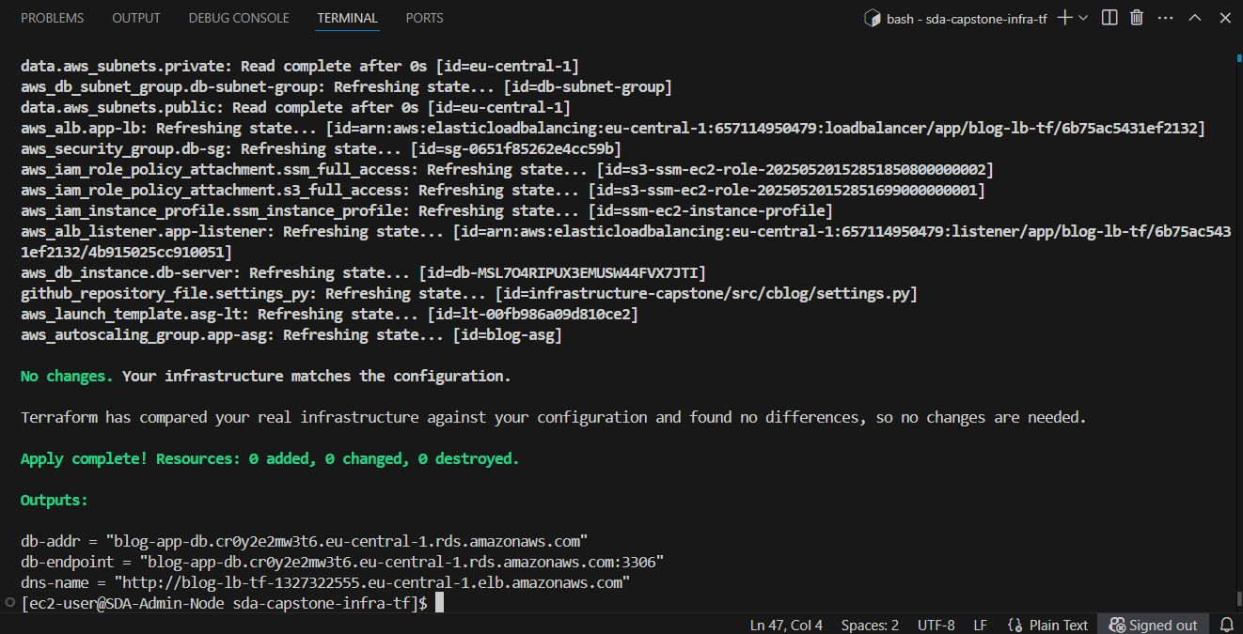
4.Technologies & Tools
Terraform Apply Output - Resources Deployed Successfully on AWS
07

Slide 9
4.Technologies & Tools
3. Monitoring: Prometheus & Grafana
Prometheus handles metric collection from the system and application, while Grafana provides real-time visualization through custom dashboards. This setup enables proactive performance monitoring and anomaly detection.
4. AWS Services: VPC, EC2, ALB, RDS, S3, SSM
The solution is fully hosted on AWS. A custom VPC isolates resources, EC2 instances host the Django app, and an Application Load Balancer manages traffic. RDS handles the database layer, S3 stores static/media files, and SSM provides secure SSH access and secrets management.
08

Slide 10
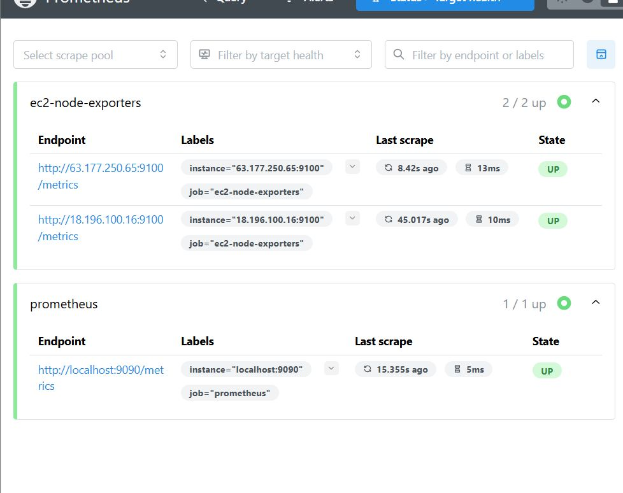
4.Technologies & Tools
Prometheus Target Status
09

Slide 11
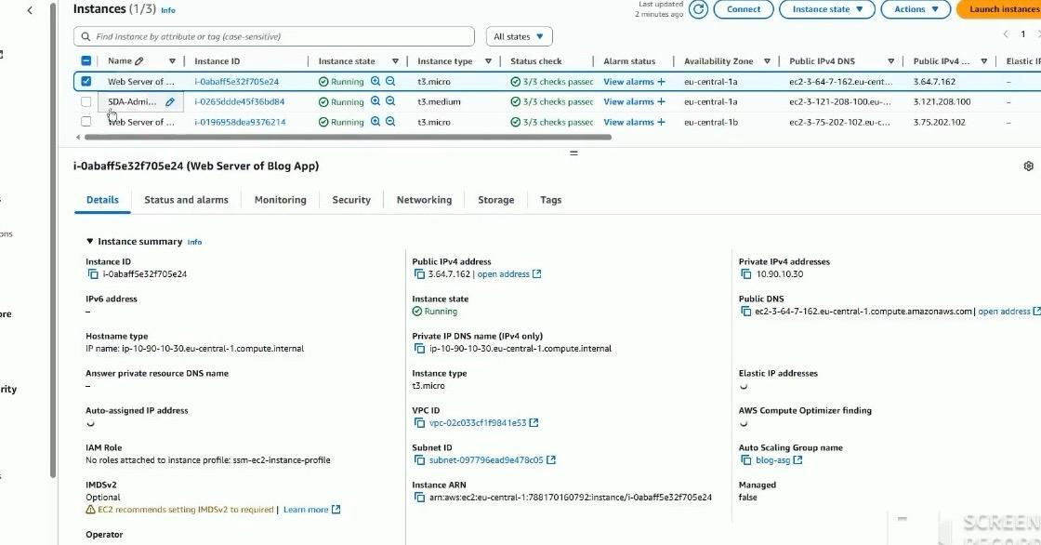
4.Technologies & Tools
EC2 & VPC
10

Slide 12
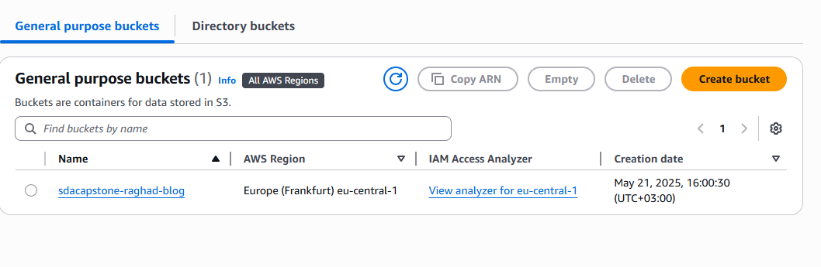
4.Technologies & Tools
S3 bucket
11

Slide 13
4.Technologies & Tools
5. Version Control: GitHub with CI/CD
Codebase and infrastructure are fully version-controlled in GitHub. GitHub Actions handles CI/CD—automating linting, testing, and deployment upon commits or pull requests. This streamlines the release process and minimizes manual errors.
12

Slide 14
5.VPC & Networking Implementation
What is a VPC?
A VPC (Virtual Private Cloud) is like your own private network inside AWS.
You can use it to run your servers, databases, and apps in a secure and controlled way
Implementation:
• Created VPC with 10.90.0.0/16 CIDR block
• 2 Public & 2 Private subnets across 2 AZs
• Public route tables → Internet Gateway
• Private route tables → NAT Gateway
• Enabled DNS hostnames for EC2 discovery
Results/Demo:
• Isolated environment for application
• High availability across two AZs
• Secure internal services (RDS)
• Cost optimization with shared NAT
13

Slide 15
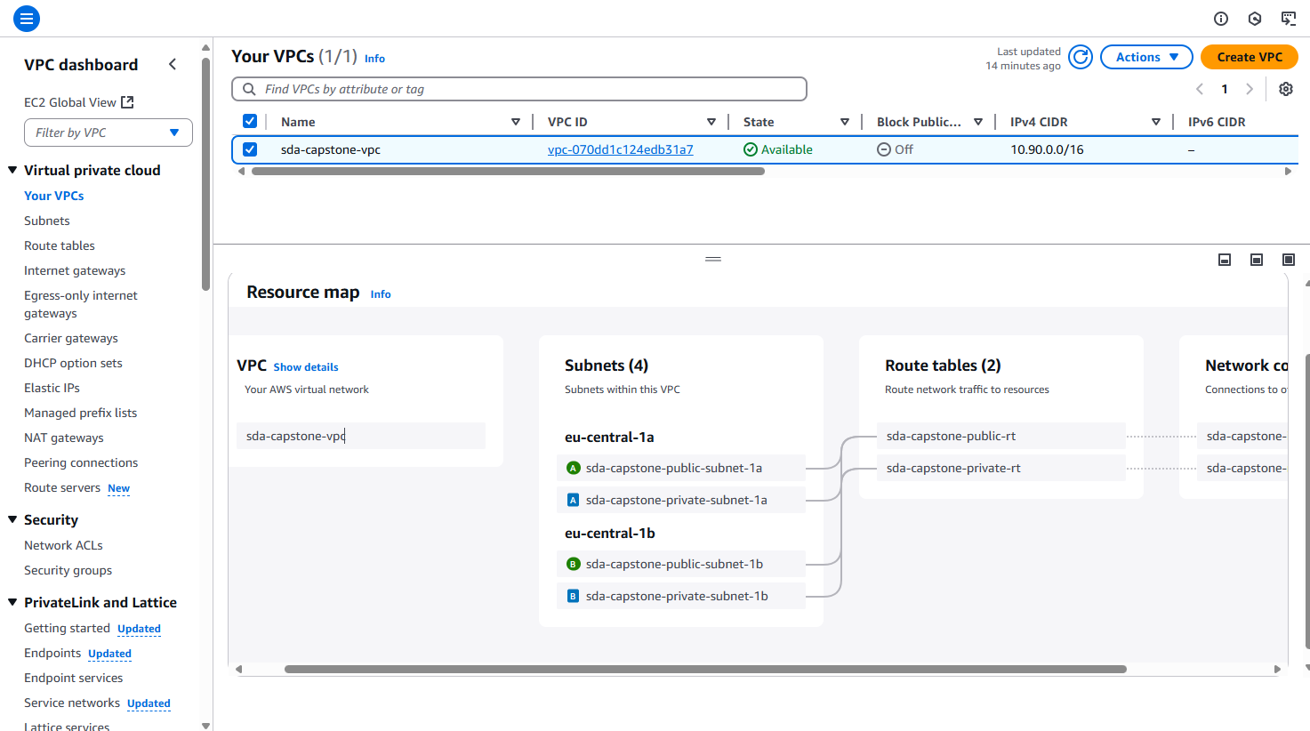
5.VPC & Networking Implementation
The screenshot below shows the VPC architecture used in our project:
14

Slide 16
6.Security Implementation
Implementation
Layered security group approach
•Results/Demo
Sensitive data stored in AWS SSM
No direct public access to instances
Private subnets for database
DB credentials never exposed
IAM roles for EC2 instances
Principle of least privilege applied
Secure access between components
S3 policies for media storage
15

Slide 17
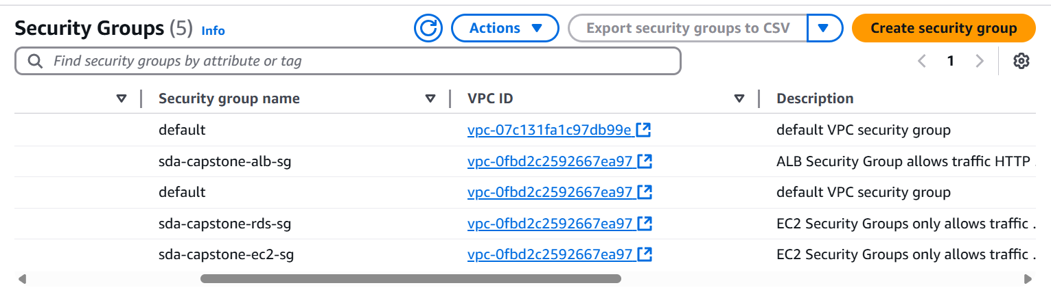
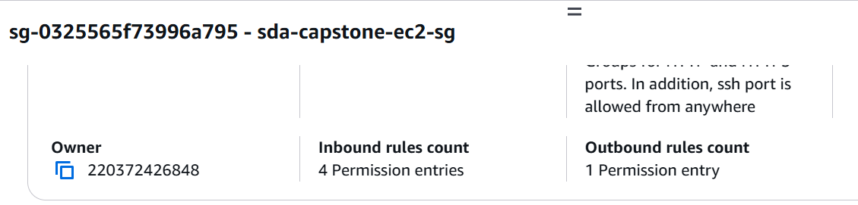
6.Security Implementation
we adopted a layered security group approach. This means that instead of a single firewall, we meticulously designed and configured specific Security Groups for each component of our architecture – from our (ALB) to our EC2 instances and RDS databases. This creates multiple, successive defensive perimeters.
to protect our most critical information, we explicitly avoided hardcoding them or storing them in configuration files. Instead, all sensitive data is securely stored in AWS Systems Manager Parameter Store (SSM). This ensures that these secrets are encrypted at rest and in transit.
16

Slide 18
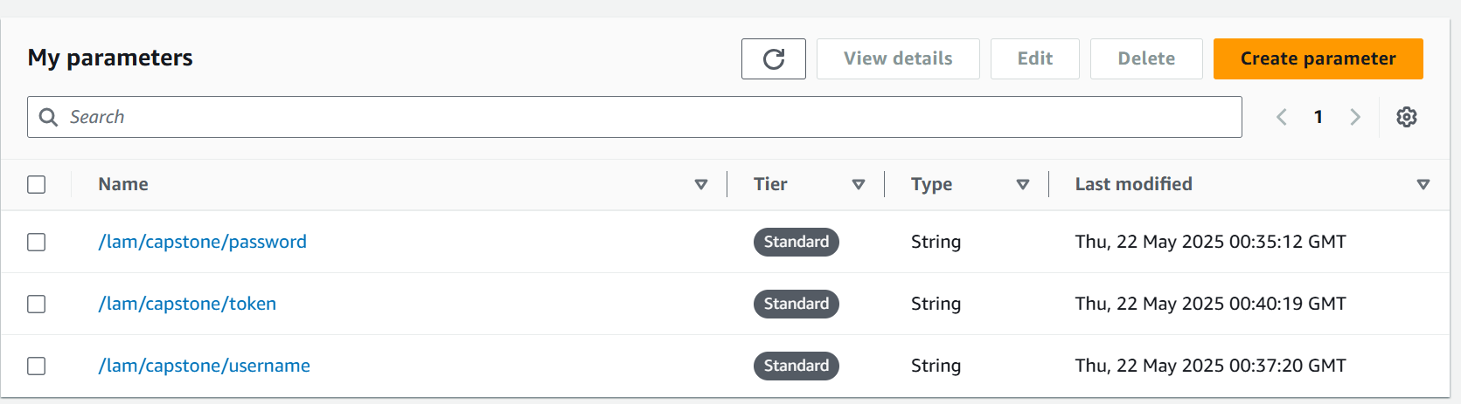
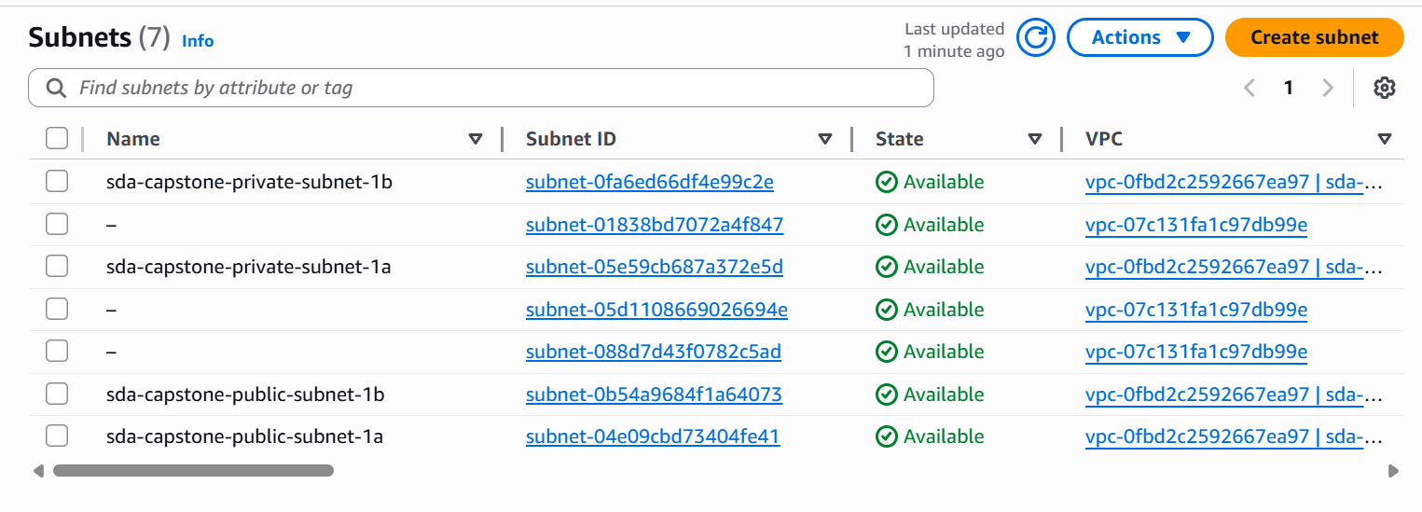
6.Security Implementation
Sensitive data stored in AWS SSM:
To protect our most critical information, such as database passwords and API keys, we explicitly avoided storing them directly in the application code or configuration files. Instead, we leveraged AWS Systems Manager Parameter Store (SSM). As you can see on this screen , we created dedicated parameters for /capstone/password, /capstone/username, and /capstone/token. This service enables us to securely store these values, encrypted, and retrieve them securely . significantly enhances our credential security.
Private subnets for database:
A crucial security measure for our database was placing it entirely within private subnets. This design prevents any direct public internet access to our RDS instance. Communication with the database is strictly limited to authorized components within our Virtual Private Cloud (VPC), significantly enhancing data isolation and protection.
17

Slide 19
7.Infrastructure as Code
Implementation
Terraform modules for reusable components
Using Terraform modules lets you reuse infrastructure
code across different projects or environments
State managed in S3 with locking
Storing the Terraform state in S3 and locking it with DynamoDB
avoids conflicts when multiple users apply changes.
GitHub actions for automated deployment
Automate the infrastructure deployment with GitHub Actions when changes are pushed.
Parameterized for environment flexibility
Make your infrastructure flexible by using variables for different environments like dev, staging, and prod.
18

Slide 20
7.Infrastructure as Code
Results / Demo
Consistent, repeatable deployments Your environments are always deployed the same way — no surprises!
Version-controlled infrastructure Track changes, roll back when needed, and collaborate safely with Git.
10-minute full environment deployment Fast deployments using GitHub Actions and Terraform.
Easy cleanup with one command
code:
terraform destroy -auto-approve
19

Slide 21
8.Configuration Management (Ansible)
Implementation:
- Configured Ansible inventory with EC2 IP and SSH key
- Created role-based structure (app roles)
- Wrote playbook to deploy the Django app
- Executed using: ansible-playbook -i inventory.ini site.yml
Results:
- EC2 instance successfully provisioned and app deployed
- All tasks executed without errors
- Re-running playbook showed idempotency
- Output: ok=2 changed=1 unreachable=0 failed=0
20

Slide 22
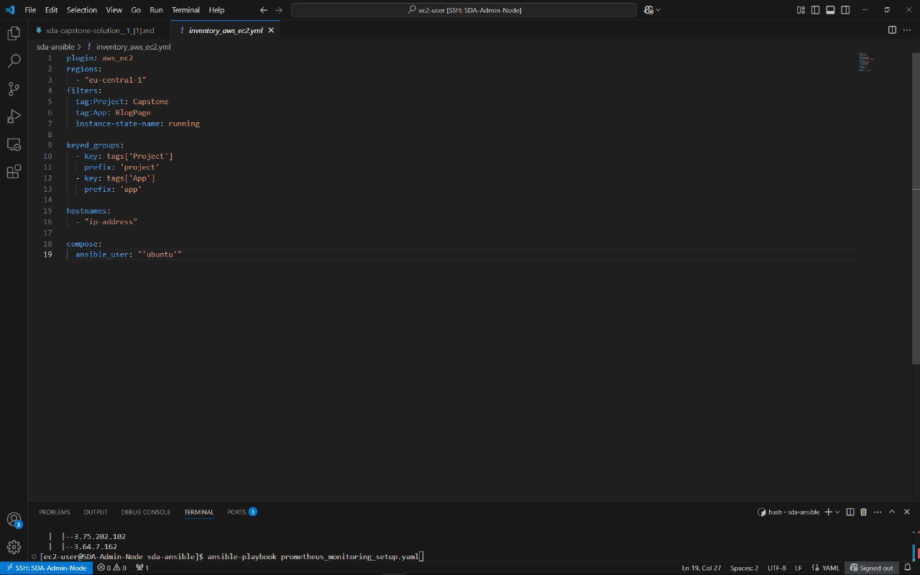
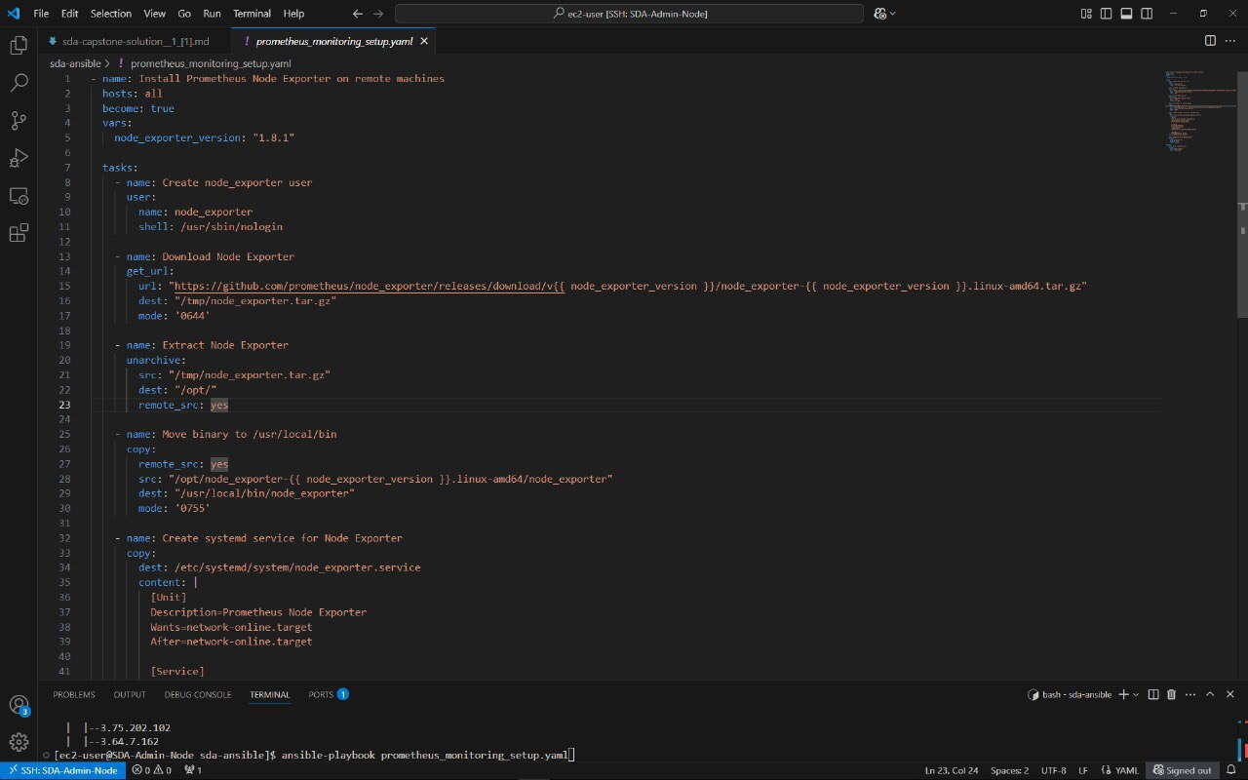
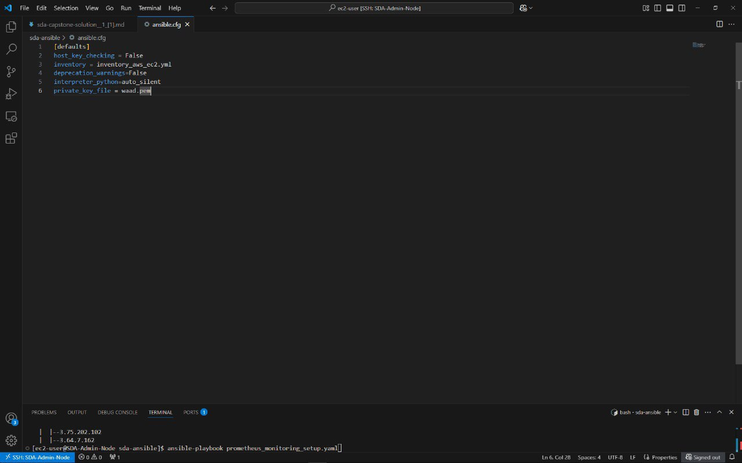
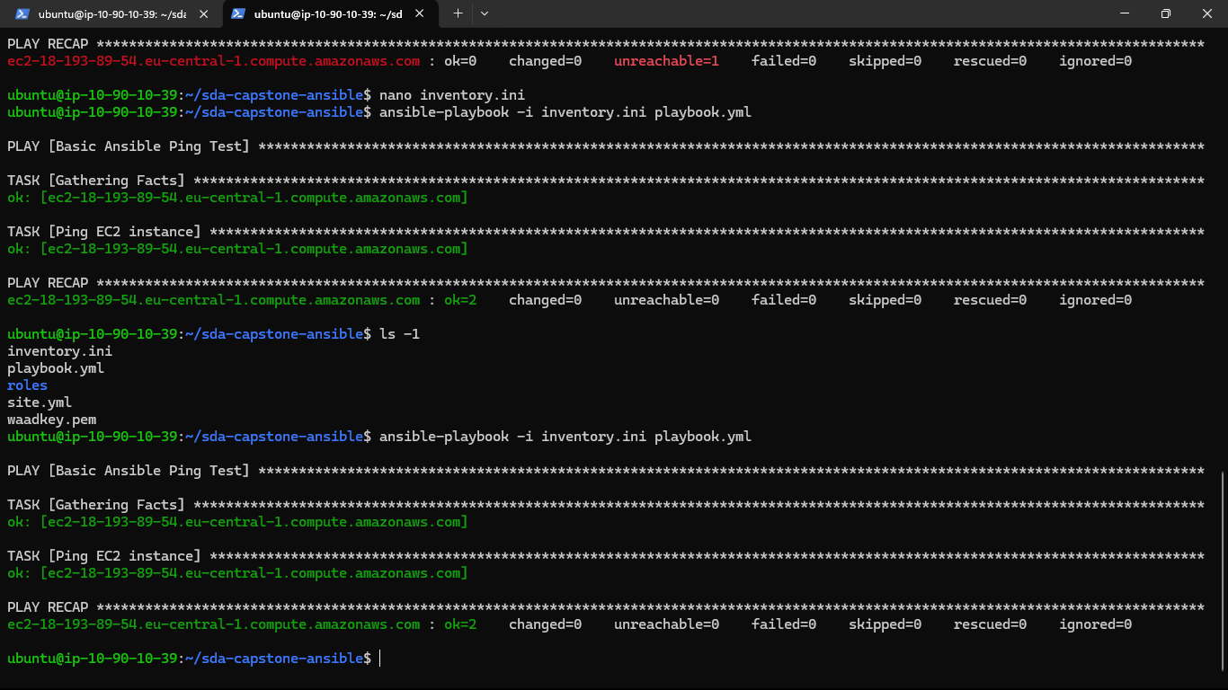
Execution Screenshots / ansible
Ansible starts connecting to EC2
Playbook runs and installs needed packages
Playbook is re-run to confirm idempotency
Final output shows successful execution
21

Slide 23
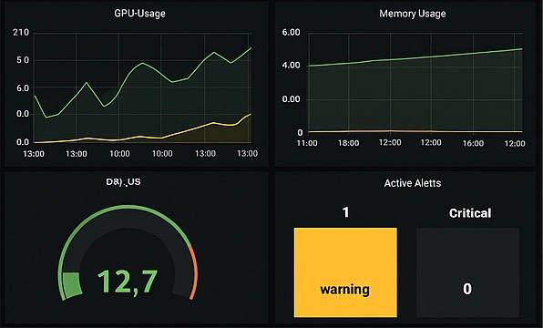
9.Monitoring Solution
01
Metrics Collection:
- Prometheus gathers system data like CPU, memory, and network usage.
- Node Exporter runs on all instances to track key performance indicators.
02
03
Alerts & Notifications:
- AlertManager sends warnings for high resource usage or system failures.
- Alerts are sent via Slack or email for quick action.
Benefits:
1- Live system monitoring with instant insights.
2- Early issue detection before failures occur.
3- Quick response to incidents, minimizing downtime.
4- Custom dashboards for better performance tracking.
Visualization & Dashboards:
- Grafana provides clear, interactive dashboards.
- Live data helps track trends and detect issues quickly.
22

Slide 24

10.Live Application Demo
23

Slide 25
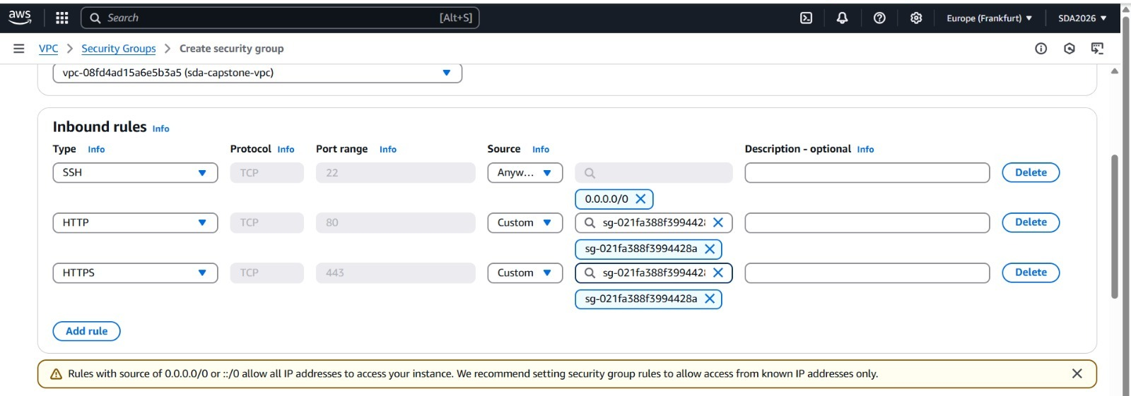
1
11. Challenges & Solutions
1. Security Configuration Complexity
Challenge:
Setting up secure communication between AWS services was challenging due to the need to manage many security rules.
Solution:
We used a Security Group Dependency Chain, where each service only talks to specific others through defined paths. This made the setup clearer and reduced the chance of security mistakes.
24
SDA2026-ORJWAN HADI

Slide 26
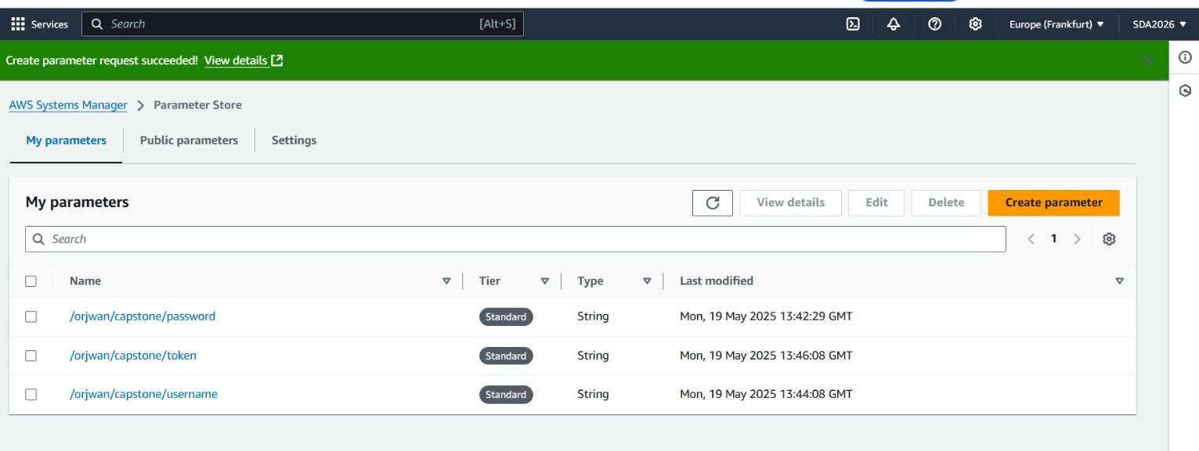
2
11. Challenges & Solutions
2. Database Configuration in Private Subnet
Challenge:
Deploying the database in a private subnet increased security but made it difficult for the application to connect without exposing credentials.
Solution:
We securely stored the database credentials in AWS Systems Manager Parameter Store, allowing the application to retrieve them dynamically when needed. This eliminated the need for hardcoded values and ensured secure access.
25
SDA2026-ORJWAN HADI

Slide 27
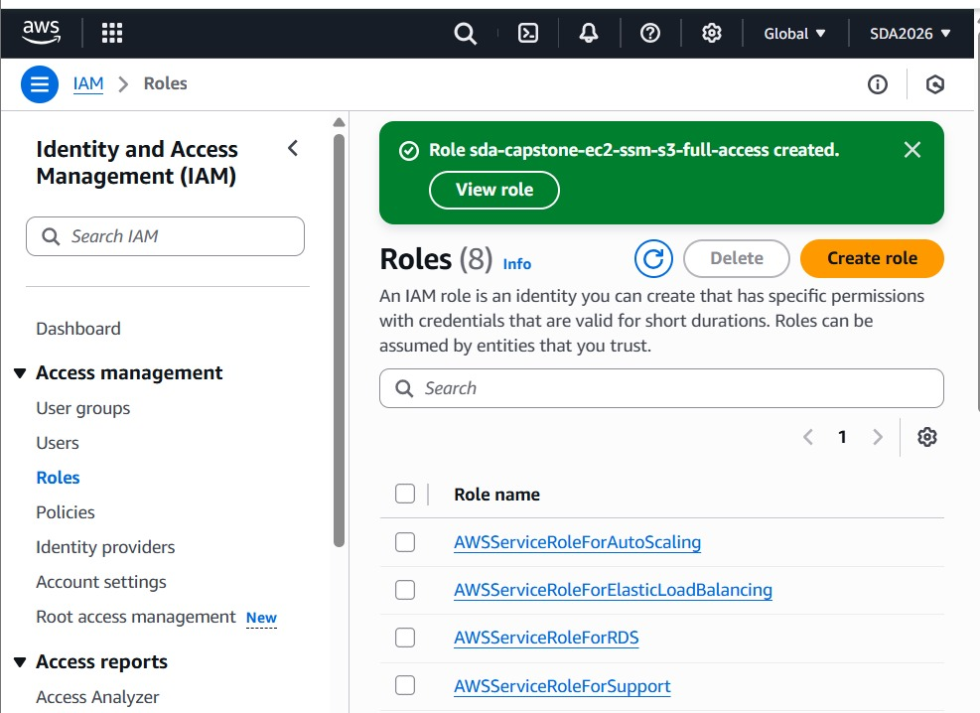
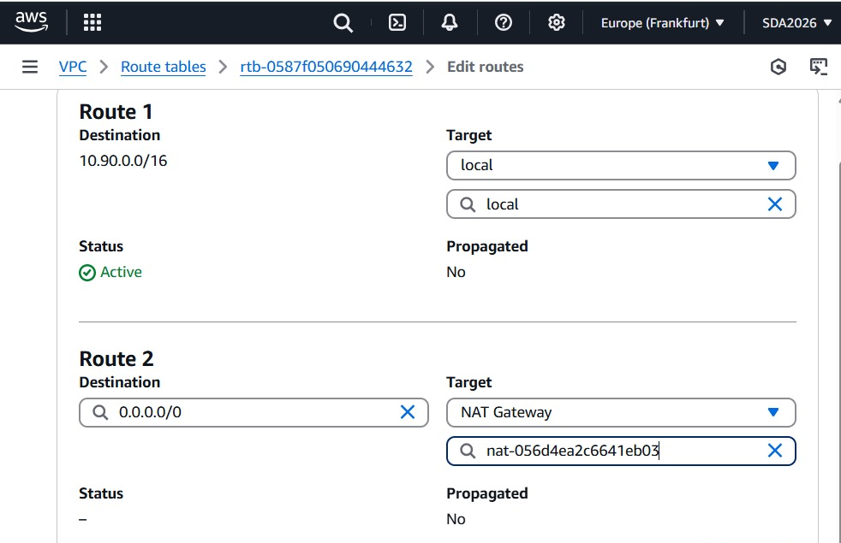
26
3
11. Challenges & Solutions
3. Auto-Scaling Lag During Deployment
Challenge:
When traffic increased, new EC2 instances started slowly because they needed time to install the required tools.
Additionally, some instances launched without the correct IAM roles, which caused failures when accessing other AWS services like S3 or RDS.
Solution:
The EC2 instance was manually prepared with all required packages before testing scaling behavior.
We also ensured the correct IAM role was attached to the instance, granting it limited but sufficient permissions to access needed resources securely.
SDA2026-ORJWAN HADI

Slide 28
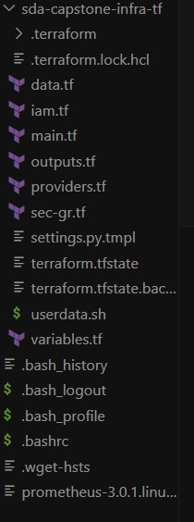
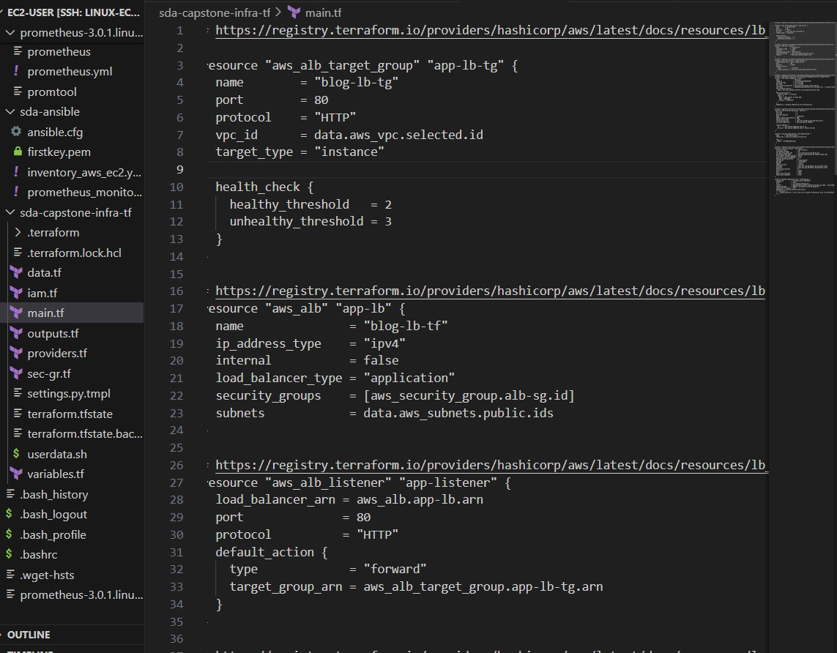
4
11. Challenges & Solutions
4.Terraform State Management
Challenge:
We needed to manage Terraform configurations and apply changes without corrupting the infrastructure setup, especially as the project grew more complex.
Solution:
We used a local terraform.tfstate file and organized our code into multiple .tf files (main.tf, variables.tf, outputs.tf, etc.). This helped us keep the infrastructure clear, modular, and manageable during deployment, even without using remote state.
27
SDA2026-ORJWAN HADI

Slide 29
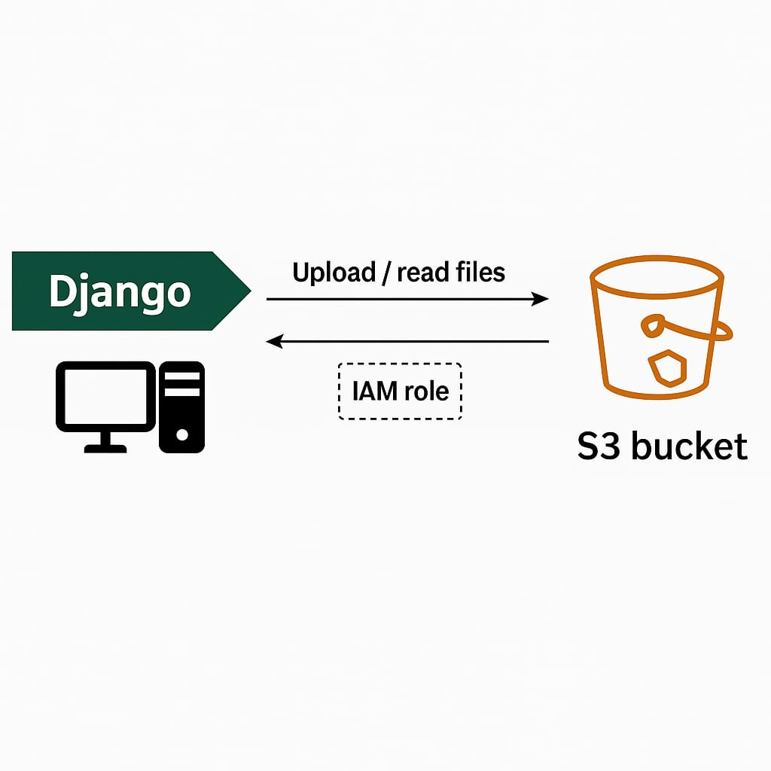
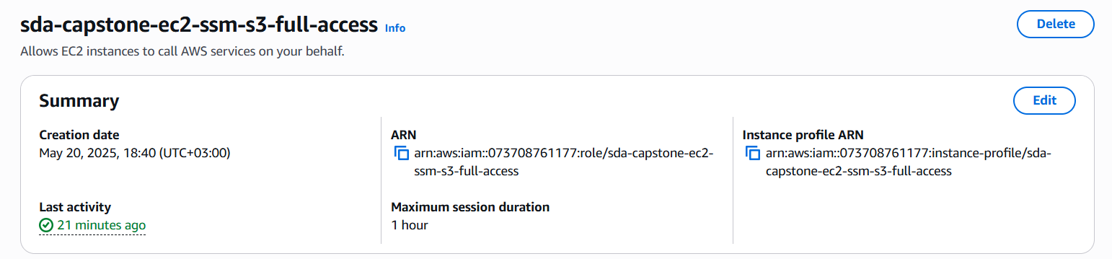
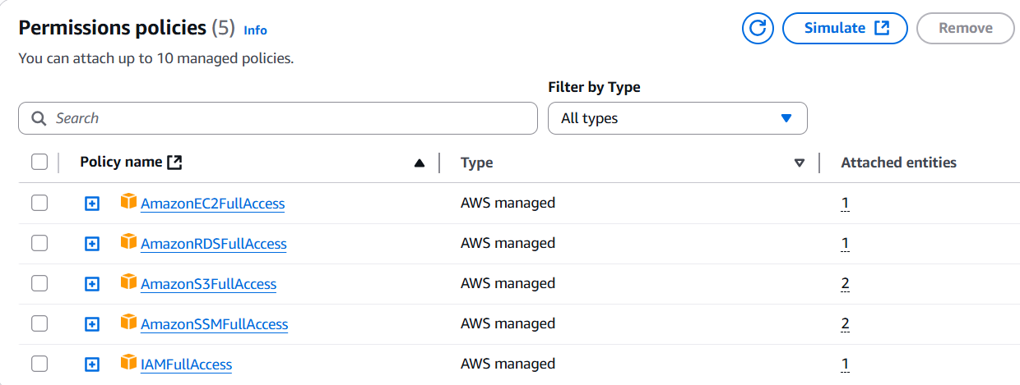
5
11. Challenges & Solutions
5. S3 Permissions for Django Integration
Challenge:
Django needed access to S3 to upload and read files, but giving it full access could be unsafe.
Solution:
We created a custom IAM policy with only the required permissions and attached it to the EC2 instance running Django. This allowed secure communication with S3 while following the least privilege principle.
28
SDA2026-ORJWAN HADI

Slide 30
12.Lessons Learned
Infrastructure as Code Essential for ensuring consistency in deployments.
Holistic Security Approach Security must be integrated across all layers and stages.
Built-in Monitoring Embed monitoring from the start to enable early issue detection.
Automation Reduces Errors Automating processes minimizes human mistakes and improves efficiency.
Comprehensive Documentation Essential for smooth team collaboration and knowledge sharing.
Self-Troubleshooting Skills Developing problem-solving skills allows for quick fixes and enhances independence.
Team Support Collaboration and communication within the team are key to resolving challenges effectively.
29

Slide 31
13.Future Enhancement
• Implement CI/CD pipeline with automated testing:
Set up automated deployment and testing to improve code quality and speed up releases.
• Add disaster recovery with cross-region replication:
Replicate data across multiple AWS regions to ensure high availability and quick recovery.
30

Slide 32
13.Future Enhancement
• Implement blue/green deployments:
Use parallel environments to deploy updates with minimal downtime.
• Add CDN for global content delivery:
Improve website performance worldwide using a Content Delivery Network like CloudFront.
• Enhance security with WAF integration:
Protect the application from common web threats using AWS Web Application Firewall.
31

Slide 33
14.conclusion
In conclusion, this project was a great chance to use what we learned during the Infrastructure Bootcamp. We used tools like Terraform and Ansible to make the deployment process easier and faster. This helped us get real experience in working with cloud infrastructure.
We would like to thank all the bootcamp instructors for their help, support, and hard work. They made this learning journey very useful and inspiring.
32

Slide 34
Thank You!
Questions?
https://github.com/L676n/Group2.git

